Slide 1
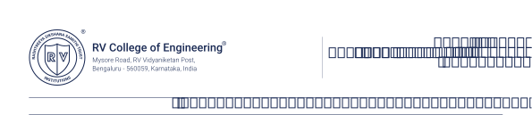

V SEMESTER
Experiential Learning - ODD 2025-26
on
Cloud Computing
Theme: SDG-15 Life on Land
Cloud-Native Wildlife Detection System: A Microservices Approach

Slide 2
Team Members
Amol Vyas | Ayush Aman | Akshat Gupta
1RV23CS032 | 1RV23CS059 | 1RV23CS027
amolvyas.cs23@rvce.edu.in | ayushaman.cs23@rvce.edu.in | akshatgupta.cs23@rvce.edu.in
MENTOR
Dr. Ramakanth Kumar P
Department of Computer Science
RV College of Engineering
Bengaluru-59

Slide 3
Contents
Introduction
Existing system
Identification of problem
Literature Review
Problem definition
Objectives
Methodology
Proposed tools and techniques.
Expected outcome.
Conclusion
References

Slide 4
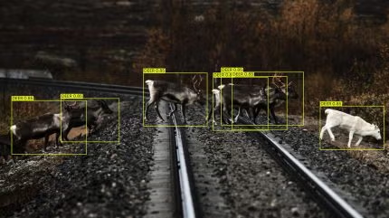
Introduction
Context: Biodiversity monitoring is essential for conservation efforts and aligns strongly with SDG 15. Field researchers now capture massive amounts of images and video through camera traps, drones, and sensor networks. Processing this volume of data quickly and accurately is becoming increasingly difficult with conventional systems.
The Shift: Traditional monolithic applications struggle to handle sudden bursts of uploads or large-scale processing workloads. When thousands of images arrive at once, these systems slow down, become unresponsive, or fail completely—making them unsuitable for modern, data-heavy workflows.
Our Solution: We propose a Wildlife Detection AI powered by a Microservices Architecture.
The user interface is cleanly separated from all intensive computation..
MinIO is used as a scalable object storage layer for images and results.
RabbitMQ manages asynchronous task queuing, allowing the system to stay stable and responsive even under heavy load.

Slide 5
Existing System
1. Manual SD Card Retrieval:
Field researchers still rely on physically collecting SD cards from camera traps. This introduces long delays—sometimes weeks—before the data can even be reviewed or analysed.
2. Monolithic Architectures:
Many existing platforms process images synchronously (upload → wait → result). During heavy usage or bulk uploads, the server slows down, becomes unresponsive, or crashes.
3. Local Storage Dependency:
Images are often stored on a local server’s filesystem, which limits scalability, complicates backup, and increases the risk of data loss.
4. Lack of Feedback:
Traditional systems act as black boxes. Users have no visibility into processing status, queue position, or system load, making the workflow unpredictable.

Slide 6
Identification of problem
Blocking Operations:
In traditional HTTP request–response setups, the server processes the image on the main thread. This blocks the UI, slows down responses, and leaves users waiting during heavy operations.
Storage Bottlenecks:
Handling thousands of high-resolution wildlife images on a local disk or conventional database quickly becomes inefficient. It increases storage costs, slows retrieval, and complicates long-term data management.
Tight Coupling:
In monolithic systems, all components depend on each other. If the AI processing module crashes or becomes overloaded, the entire web server can stall or fail.
Scalability Limits:
Monolithic designs make it impossible to scale the processing engine independently. The worker and web server grow together, preventing efficient scaling during spikes in image uploads.

Slide 7

Literature Review
Paper | Summary | Author | Publication
Automatically identifying, counting, and describing wild animals in camera-trap images with deep learning | This is a seminal paper that demonstrates deep learning can automate animal identification with 96.6% accuracy (matching human volunteers). | Norouzzadeh, M. S. et al. | Proceedings of the National Academy of Sciences (PNAS), Vol. 115, Issue 25, pp. E5716-E5725, 2018.
An AI-based Wild Animal Detection System and Its Application. | This paper describes a complete end-to-end system similar to yours, which integrates image sensors, edge computing boxes, and a data visualization platform. | Lin, C. et al. | Biodiversity Data Journal, Vol. 11, e108343, 2023.

Slide 8
Literature Review
Paper | Summary | Author | Publication
Real-Time Farm Surveillance Using IoT and YOLOv8 for Animal Intrusion Detection. | This recent study explicitly compares models like VGG16, AlexNet, and YOLOv8, concluding that YOLOv8 is the most promising with >99% precision for real-time intrusion detection. | Christian Randieri, et al. | Electronics, MDPI, Vol. 17, Issue 2, 2025.
Real-Time Tracking of Wildlife with IoT Solutions in Movement Ecology. | Discusses the integration of Internet of Things (IoT) with wildlife tracking to provide "immediate" data rather than waiting for manual SD card retrieval. | Chenna Reddy, et al. | ResearchGate Publication, 2023.

Slide 9
Literature Review
Paper | Summary | Author | Publication
YOLO-WildASM: An Object Detection Algorithm for Protected Wildlife. | This paper introduces a specialized YOLO architecture for "protected wildlife" that handles small targets and occluded backgrounds (animals hiding behind trees). It serves as a great "Future Scope" reference, showing how one could upgrade the standard YOLO model to a specialized one. | Mathew Crowther, et al. | Animals, MDPI, Vol. 15, Issue 18, 2025.
Deep learning-based ecological analysis of camera trap images is impacted by training data quality and size. | This paper analyzes how training data quality affects the ecological metrics derived from AI models. It explains why reliable storage (MinIO) and high-quality image ingestion pipelines are critical for scientific accuracy. | Peggy A. Bevan, et al. | Nature Ecology & Evolution (Contextual/ResearchGate), 2024.

Slide 10
Problem Definition
There is a growing need for a reliable, cloud-native platform that can ingest large volumes of wildlife imagery, store them securely, and run AI-based analysis without slowing down or interrupting the user experience.
The platform must support high-concurrency uploads, remain responsive under load, and process images asynchronously so that heavy computation never blocks the UI.
It should also ensure a clear separation between the frontend and the backend, so that failures or delays in the AI processing pipeline do not impact user interactions.
Overall, the problem is to design a system that is scalable, fault-tolerant, and capable of handling real-world field data efficiently.

Slide 11
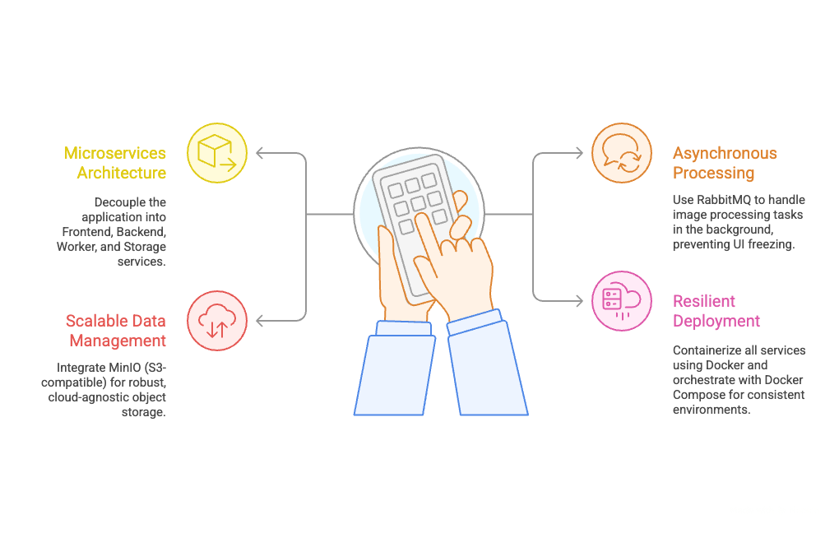
Objectives

Slide 12
Methodology
1. User Interaction:
The user accesses the React (Vite) frontend to upload images of wildlife.
2.API Handling:
The FastAPI backend receives the image. Instead of processing it immediately, it performs two actions:
a. Saves the raw image to a specific bucket in MinIO.
b. Publishes a "New Task" message to the RabbitMQ queue.
3.Task Ingestion:
A dedicated Python Worker service, listening to the queue, picks up the message.
4.Processing & Simulation:
The Worker downloads the image from MinIO. Then it runs the AI Detection logic and, results are tagged and re-uploaded/saved to MinIO.
5.Result Polling:
The Frontend periodically polls the Backend, which fetches the processed results from MinIO and displays them to the user.

Slide 13
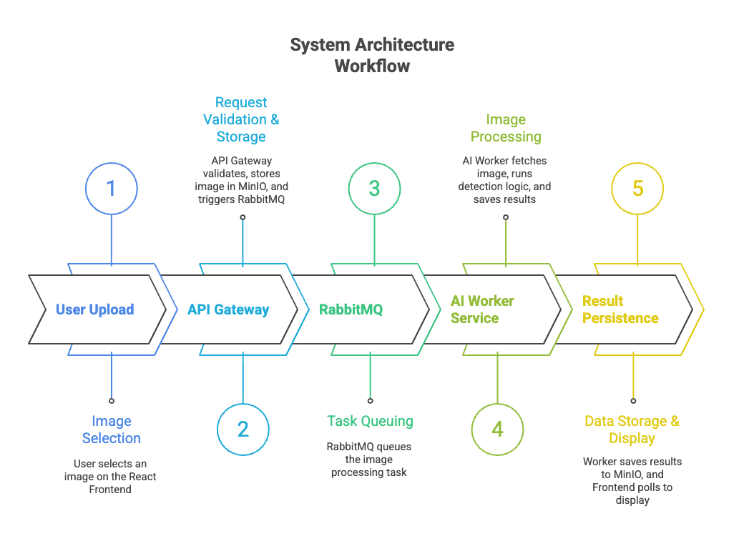
Methodology

Slide 14
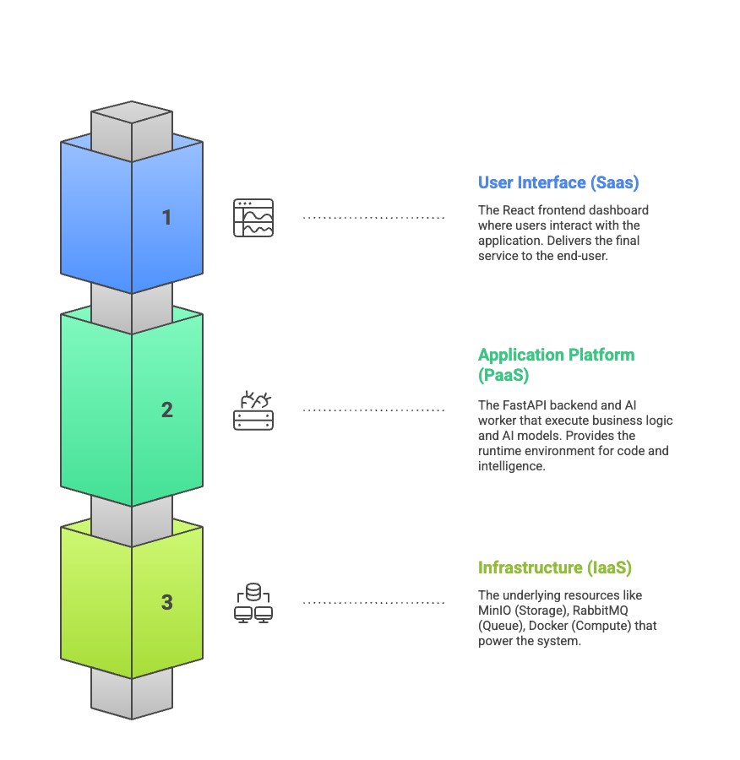
Methodology

Slide 15
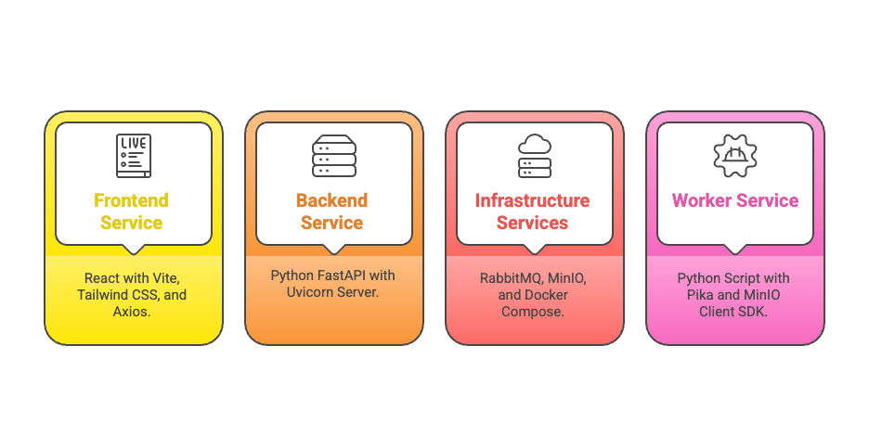
Proposed tools and techniques

Slide 16
Expected Outcomes
1.High Availability:
The frontend remains responsive even if the AI worker is busy processing hundreds of images.
2.Data Durability:
Images are safely stored in MinIO, independent of the application server's life cycle.
3.Scalability:
The architecture allows us to spawn multiple "Worker" containers in the future to handle higher loads without changing the code.
4.Modern UX:
A seamless, non-blocking user experience provided by the React + FastAPI integration.

Slide 17
Conclusion
• Modernizes Wildlife Data Processing
Demonstrates how cloud-native design can replace slow, monolithic workflows used in traditional biodiversity monitoring.
• Microservices Improve Reliability
Decoupled components make the system easier to maintain, less prone to failures, and better suited for real-world field conditions.
• Asynchronous Architecture Works at Scale
Combining RabbitMQ, MinIO, and containerized services enables smooth, high-volume image processing without blocking the user experience.
• Strong Foundation for Future Expansion
The architecture can be extended with real AI models, automated cloud deployments, and additional ecological applications.

Slide 18
References
Norouzzadeh, M. S. et al. (2018). "Automatically identifying, counting, and describing wild animals in camera-trap images with deep learning." Proceedings of the National Academy of Sciences (PNAS), 115(25).
Lin, C. et al. (2023). "An AI-based Wild Animal Detection System and Its Application." Biodiversity Data Journal, 11, e108343.
MDPI Electronics Team. (2025). "Real-Time Farm Surveillance Using IoT and YOLOv8 for Animal Intrusion Detection." Electronics, 17(2).
Research Team. (2023). "Real-Time Tracking of Wildlife with IoT Solutions in Movement Ecology." ResearchGate Publication.
MDPI Animals Team. (2025). "YOLO-WildASM: An Object Detection Algorithm for Protected Wildlife." Animals, 15(18).
Ecological Metrics Group. (2024). "Deep learning-based ecological analysis of camera trap images is impacted by training data quality." Nature Ecology & Evolution.

Slide 19
Thank You

